Slide 1

Online Encounter 19
Notes:
ENCOUNTER 19
REVIEW STUDENT PROGRESS
Check for last Encounter attendance.
Check for last Speaking Center attendance and time spent.
Check that Lesson 3 has been completed.
Prepare general comments on Student attendance, study habits, and overall progress.
VIDEO SUMMARY
Todd decides that The Company Company needs a stricter dress code, which he describes to the staff in a meeting. The staff members do not share his enthusiasm for the new rules. Aanya, Khae, and Marco make fun of Todd on social media using a picture that Marco created using Photoshop.
Shen gets annoyed with Benny's loud music, but his mood changes when his agent, Marti Blum, phones to offer him a job working with Dan Blaze. Benny and Shen get in trouble with Paz, Shen's neighbor, due to the noise.
Diego and Sofi have too much food in storage, so they invite their friends to the restaurant to help them get rid of it. After a very busy day, Sofi sends a postcard to her friend Beatrice in France.
VOCABULARY OBJECTIVE
Can name some basic articles of clothing (dress; hat; jacket, jeans; pants, skirt; socks; suit; sweater; t-shirt; tennis shoes; tie; top; trainers; trousers)
GRAMMAR OBJECTIVES
Can express polite offers and preference using would like/would like to (Would you like me to turn it down?)
Can describe quantity using not + much/many with some control (There isn’t much room to walk in here.)

Slide 2

Encounter 19
Introductions
Your teacher
My name is .
Now please introduce yourself.
Notes:
INSTRUCTIONS
This is a warm-up activity and should not be assessed.
Introduce yourself to the Students. Then ask each individual Student what his/her name is. Tell the Students:
Hello. My name’s _______. What’s your name?
Sample Responses: My name’s _______./My name is _______.
TEACHING TIPS
Ask the Students about their study habits. (i.e., “Have you finished your Speaking Center Lessons? How about your Student Manual or Digital Book?”)
Check for IT issues.

Slide 3

Part 1.0: Warm-Up
What’s your name?
Where do you live?
Notes:
1.1 Question Tennis (5 min)
Allow five minutes for this slide.
OBJECTIVE
To help the Students relax and start thinking in English
INSTRUCTIONS
Choose one Student and say, “(Student’s Name) I'm going to ask you a question. Don't answer the question! Say a classmate’s name. Then ask a different question to him/her.”
Ask the Student a question, for example, “What's your name?”
The Student should ask another Student a different question, for example, “(New Student’s Name), where do you live?”
Ask that Student to continue the game, and ask another question to a different Student.
When the Students understand the concept, say, “We are going to play a game. The first Student serves by asking another Student a question. He or she returns by asking another question to a different Student.”
Before beginning, explain the rules:
The Students must respond quickly.
Once one Student has used a question, the other Students cannot repeat it.
The Students must not answer questions.
TEACHING TIP
This is a warm-up activity and should not be assessed.

Slide 4

Part 2.0: Target Language
Activity 2.1: Context Creation
.
She’s wearing a blue shirt, jeans, and tennis shoes
What is she wearing?
Notes:
2.1 What Are They Wearing? (10 min)
Allow one minute for this slide.
OBJECTIVE
Can name some basic articles of clothing (dress; hat; jacket, jeans; pants, skirt; socks; suit; sweater; t-shirt; tennis shoes; tie; top; trainers; trousers)
INSTRUCTIONS
#1. Have a Student read the question. [What’s she wearing?]
#2. Encourage the Students to answer. Insist on full sentences and encourage the Students to add adjectives if possible.
#3. Reveal the answer. [She’s wearing a blue shirt, jeans, and tennis shoes.]
TEACHING TIPS
Elicit a variety of the target vocabulary.
Elicit from each student.
It helps to board elicited language.

Slide 5
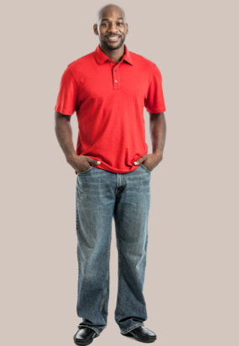
Part 2.0: Target Language
Activity 2.1: Context Creation
.
He’s wearing a red shirt, jeans, and nice shoes
What’s he wearing?
Notes:
2.1 What Are They Wearing?
Allow one minute for this slide.
INSTRUCTIONS
#1. Have a Student read the question. [What’s he wearing?]
#2. Encourage the Students to answer.
#3. Reveal the answer. [He’s wearing a red shirt, jeans, and nice shoes.]
TEACHING TIPS
Elicit a variety of the target vocabulary.
Elicit from each student.
It helps to board elicited language.

Slide 6
Part 2.0: Target Language
Activity 2.1: Concept Check
What other things can people wear?
a hat and a jacket
Notes:
2.1 What Are They Wearing?
Allow one minute for this slide.
INSTRUCTIONS
#1. Concept check by having a Student read the question. [What other things can people wear?]
#2. Encourage the Students to answer.
#3. Reveal the sample answers. [a hat and a jacket]
TEACHING TIP
Elicit target language from each Student.

Slide 7
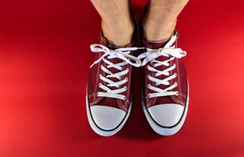

Part 2.0: Target Language
Activity 2.1: Practice
?
A
.
B
Notes:
2.1 What Are They Wearing?
Allow two minutes for this slide.
INSTRUCTIONS
Have the Students ask and answer the target question about what the person is wearing.
ANSWER KEY
A: What’s he wearing?
B: He’s wearing tennis shoes/trainers/sneakers.
A: What’s she wearing?
B: She’s wearing jeans.

Slide 8


Part 2.0: Target Language
Activity 2.1: Practice
?
A
.
B
Notes:
2.1 What Are They Wearing?
Allow two minutes for this slide.
INSTRUCTIONS
Have the Students ask and answer the target question about what the person is wearing.
ANSWER KEY
A: What’s she wearing?
B: She’s wearing a dress.
A: What’s he wearing?
B: He’s wearing a hat.

Slide 9


Part 2.0: Target Language
Activity 2.1: Practice
?
A
.
B
Notes:
2.1 What Are They Wearing?
Allow two minutes for this slide.
INSTRUCTIONS
Have the Students ask and answer the target question about what the person is wearing.
ANSWER KEY
A: What’s he wearing?
B: He’s wearing a suit.
A: What’s he wearing?
B: He’s wearing a t-shirt.

Slide 10

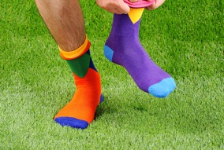
Part 2.0: Target Language
Activity 2.1: Practice
?
A
.
B
Notes:
2.1 What Are They Wearing?
Allow one minute for this slide.
INSTRUCTIONS
Have the Students ask and answer the target question about what the person is wearing.
ANSWER KEY
A: What’s she wearing?
B: She’s wearing a sweater.
A: What’s he wearing?
B: He’s wearing socks.

Slide 11



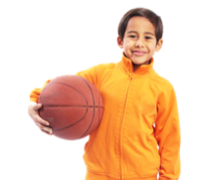




Part 2.0: Target Language
Activity 2.1: Extension
A
B
C
D
E
F
G
H
Notes:
2.1 What Are They Wearing?
Optional Extension
INSTRUCTIONS
Say to the Students, “I’m going to describe someone I can see. Can you guess who?”
Describe someone on the screen by talking about their clothing. For example,
Teacher: She’s wearing a dark jacket, pants, and a white shirt. She has dark shoes.
Student: Is it letter E, the woman holding bags?
Teacher: Yes, it is.
Have the Students take turns describing people on the screen. Ask the other Students to guess who the first Student is talking about.

Slide 12
Part 2.0: Target Language
Activity 2.1: Feedback
Student 1
Student 2
Student 3
Student 4
Great job!
Great job!
Great job!
Great job!
Well done
Well done
Well done
Well done
Good try
Good try
Good try
Good try
More practice
More practice
More practice
More practice
Feedback
Notes:
2.1 What Are They Wearing?
FEEDBACK
Quickly give the Students feedback on the target language they just practiced.
Remind them of other resources they can take advantage of to improve their English:
Go to Wall Street World to practice grammar and vocabulary.
Review the Student Manual or Digital Book to study grammar and vocabulary.
Attend Complementary Classes to practice using grammar and vocabulary.
Join Social Clubs to practice speaking skills.

Slide 13


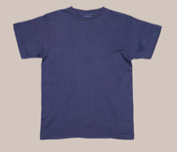
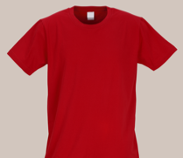
Part 3.0: Target Structures
Activity 3.1: Context Creation
What are these?
blue
.
They’re t-shirts
red
Notes:
3.1 Making Choices (10 min)
Allow one minute for this slide.
OBJECTIVE
Can express polite offers and preference using would like/would like to (Would you like me to turn it down?)
INSTRUCTIONS
Draw the Students’ attention to the images of the t-shirts.
#1. Have a Student read the question. [What are these?]
#2. Encourage the Students to answer.
#3. Reveal the answer. [They’re t-shirts.]
Say to the Students, “You are in a clothes shop. You want to buy a t-shirt. Which one do you choose? What do you say to the salesperson at the clothing store?”
Elicit, “I want to buy the red/blue t-shirt.”
TEACHING TIPS
If the Students struggle to produce “I want” or “I would like to,” write gapped sentences on the board.
I _____ to buy the red/blue T-shirt.
I _____ to buy the red/blue T-shirt.
Elicit examples of the target structure(s).
Elicit from each student.
It helps to board elicited language.

Slide 14

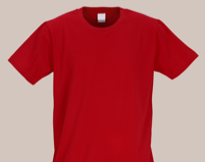
Part 3.0: Target Structures
Activity 3.1: Context Creation
.
I would like to
buy a T-shirt
What’s a nicer way to say “want”?
Notes:
3.1 Making Choices
Allow one minute for this slide.
INSTRUCTIONS
#1. Have a Student read the question. [What’s a nicer way to say “want”?]
#2. Encourage the Students to answer.
#3. Reveal the answer. [I would like to buy a t-shirt.]
Ask the Students, “Which do you use, ‘want’ or ‘would like,’ to talk to a boss, and which do you use to talk to a friend?”
The Students should respond that “would like” is used to talk to a boss, and “want” with a friend.
TEACHING TIPS
If the Students struggle to produce “I want” or “I would like to,” write gapped sentences on the board.
I _____ to buy the red/blue T-shirt.
I _____ to buy the red/blue T-shirt.
Elicit examples of the target structure(s).
Elicit from each student.
It helps to board elicited language.

Slide 15

Part 3.0: Target Structures
Activity 3.1: Concept Check
?
Would you like to buy the red or blue t-shirt
You are the salesperson in the clothing store. You want to sell me one of the t-shirts. What question will you ask me?
Notes:
3.1 Making Choices
Allow one minute for this slide.
INSTRUCTIONS
Concept check by having a Student read the statements and question. [You are the salesperson in the clothing store. You want to sell me one of the t-shirts. What question will you ask me?]
#1. Encourage the Students to answer.
#2. Reveal the answer. [Would you like to buy the red or blue T-shirt?]
TEACHING TIP
Elicit target language from each Student.

Slide 16
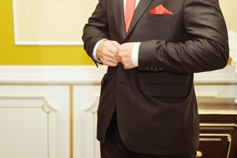
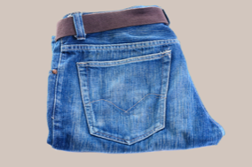


Part 3.0: Target Structures
Activity 3.1: Practice
buy?
wear to work?
or
or
Notes:
3.1 Making Choices
Allow two minutes for this slide.
INSTRUCTIONS
Draw the Students’ attention to the text at the top of the screen and the two images. Encourage them to use these cues to ask and answer the target question.
ANSWER KEY
A: Would you like to buy the suit or the t-shirt?
B: I'd like to buy...
A: Would you like to wear the suit or the jeans to work?
B: I'd like to wear...
TEACHING TIP
If the Students use “want,” encourage them to be more polite to each other.

Slide 17

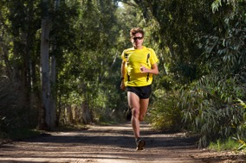

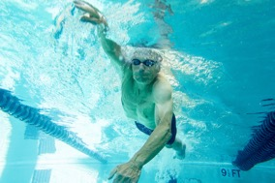
Part 3.0: Target Structures
Activity 3.1: Practice
have?
go?
or
or
Notes:
3.1 Making Choices
Allow one minute for this slide.
INSTRUCTIONS
Draw the Students’ attention to the text at the top of the screen and the two images. Encourage them to use these cues to ask and answer the target question.
ANSWER KEY
A: Would you like to have coffee or tea?
B: I'd like to have...
A: Would you like to go running or swimming?
B: I'd like to go...
TEACHING TIP
If the Students use “want,” encourage them to be more polite to each other.

Slide 18
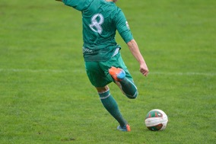


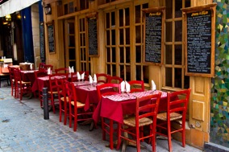
Part 3.0: Target Structures
Activity 3.1: Practice
play?
go?
or
or
Notes:
3.1 Making Choices
Allow one minute for this slide.
INSTRUCTIONS
Draw the Students’ attention to the text at the top of the screen and the two images. Encourage them to use these cues to ask and answer the target question.
ANSWER KEY
A: Would you like to play soccer (football) or basketball?
B: I'd like to play...
A: Would you like to go to the movies or to a restaurant?
B: I'd like to go...
TEACHING TIP
If the Students use “want,” encourage them to be more polite to each other.

Slide 19

Part 3.0: Target Structures
Activity 3.1: Practice
.
.
Notes:
3.1 Making Choices
Allow three minutes for this slide.
INSTRUCTIONS
After the Students have discussed all of the preceding screens, get feedback in open class by asking, “What did you learn from your classmates?”
Elicit answers from each Student. For example,
Juan would like to go swimming because it’s relaxing.
Kana would like to have tea because she doesn’t like coffee.

Slide 20
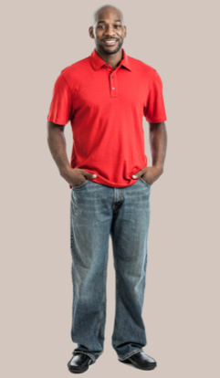

Part 3.0: Target Structures
Activity 3.1: Extension
Would you ?
I’d .
Notes:
3.1 Making Choices
Optional Extension
INSTRUCTIONS
The Students have one minute to think of three questions of their own using “would like.” The questions should be in the same form as those on the preceding screens, with a choice between two alternatives.
The Students ask and answer their questions with their classmates. Allow four minutes for the Students to speak.

Slide 21
Part 3.0: Target Structures
Activity 3.1: Feedback
Student 1
Student 2
Student 3
Student 4
Great job!
Great job!
Great job!
Great job!
Well done
Well done
Well done
Well done
Good try
Good try
Good try
Good try
More practice
More practice
More practice
More practice
Feedback
Notes:
3.1 Making Choices
FEEDBACK
Quickly give the Students feedback on the target language they just practiced.
Remind them of other resources they can take advantage of to improve their English:
Go to Wall Street World to practice grammar and vocabulary.
Review the Student Manual or Digital Book to study grammar and vocabulary.
Attend Complementary Classes to practice using grammar and vocabulary.
Join Social Clubs to practice speaking skills.

Slide 22

Part 3.0: Target Structures
Activity 3.2: Context Creation
Yes, the movies.
Would you like to go to the movies tomorrow?
I’d like to go to
.
No. That’s not a lot
You want to go to the movies, but there are only two tickets left. Are two tickets a lot?
.
There aren’t many tickets
Notes:
3.2 There Aren’t Many Eggs (10 min)
Allow two minutes for this slide.
OBJECTIVE
Can describe quantity using not + much/many with some control (There isn’t much room to walk in here.)
INSTRUCTIONS
#1. Have a Student read the question. [Would you like to go to the movies tomorrow?]
#2. Encourage a Student to complete the answer. [Yes, ____________ the movies.]
#3. Reveal the answer. [Yes, I’d like to go to the movies.]
#4. Have a Student read the statement and question. [You want to go to the movies, but there are only two tickets left. Are two tickets a lot?]
#5. Encourage the Students to answer.
#6. Reveal the answer [No. That’s not a lot.] Then ask, “How can we say ‘not a lot’ in another way?”
#7. Encourage the Students to answer.
#8. Reveal the answer. [There aren't many tickets.]
TEACHING TIPS
Elicit examples of the target structure(s).
Elicit from each student.
It helps to board elicited language.

Slide 23
Part 3.0: Target Structures
Activity 3.2: Context Creation
popcorn.
At the movies, you would like some popcorn. But there is only enough for one person.
There isn’t much
Notes:
3.2 There Aren’t Many Eggs
Allow one minute for this slide.
INSTRUCTIONS
#1. Have a Student read the statements. [At the movies, you would like some popcorn. But there is only enough for one person.] Ask the Students, “How can we say ‘not a lot’ with popcorn?” Elicit a polite response.
#2. Encourage a Student to complete the answer. [____________ popcorn.]
#3. Reveal the answer. [There isn't much popcorn.]
TEACHING TIPS
Elicit examples of the target structure(s).
Elicit from each student.
It helps to board elicited language.

Slide 24


Part 3.0: Target Structures
Activity 3.2: Context Creation
tickets
many
popcorn
much
Notes:
3.2 There Aren’t Many Eggs
Allow one minute for this slide.
INSTRUCTIONS
#1. Encourage the Students to read the text, filling in the missing word to complete the phrase. [____ tickets]
#2. Reveal the answer and have the Students read the phrase. [many tickets]
#3. Encourage the Students to read the text, filling in the missing word to complete the phrase. [____ popcorn]
#4. Reveal the answers and have Students read the phrase. [much popcorn]
TEACHING TIPS
Elicit examples of the target structure(s).
Elicit from each student.
It helps to board elicited language.

Slide 25

Part 3.0: Target Structures
Activity 3.2: Concept Check
much time, many cars
I say “much popcorn” and “many tickets.” What other words get “much”? How about “many”?
Notes:
3.2 There Aren’t Many Eggs
Allow one minute for this slide.
INSTRUCTIONS
#1. Concept check by having a Student read the statement and questions. [I say “much popcorn” and “many tickets.” What other words get “much”? How about “many”?]
#2. Encourage the Students to answer.
#3. Reveal the sample answers. [much time, many cars]
TEACHING TIP
Elicit target language from each Student.

Slide 26
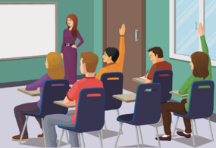


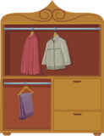
Part 3.0: Target Structures
Activity 3.2: Practice
A
B
C
D
Notes:
3.2 There Aren’t Many Eggs
Allow three minutes for this slide.
INSTRUCTIONS
Say to the Students, “Talk to your classmates. Take turns speaking. Make sentences about the pictures on the screen.”
The Students take turns to make sentences using the pictures they see on the screen, for example,
A: There aren't many people/students in the class.
B: There isn’t much water in the glass.
ANSWER KEY (sample answers)
A. There aren't many people/students in the class.
B. There isn't much water in the glass.
C. There isn't much time.
D. There aren't many clothes in the closet.

Slide 27

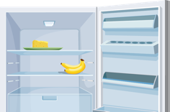
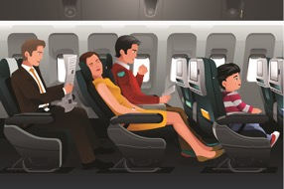

Part 3.0: Target Structures
Activity 3.2: Practice
A
B
C
D
Notes:
3.2 There Aren’t Many Eggs
Allow two minutes for this slide.
INSTRUCTIONS
Say to the Students, “Talk to your classmates. Take turns speaking. Make sentences about the pictures on the screen.”
The Students take turns to make sentences using the pictures they see on the screen.
ANSWER KEY (sample answers)
A. There aren't many eggs in the box.
B. There isn't much food in the fridge.
C. There aren’t many people on the airplane.
D. There aren’t many people in the swimming pool.

Slide 28
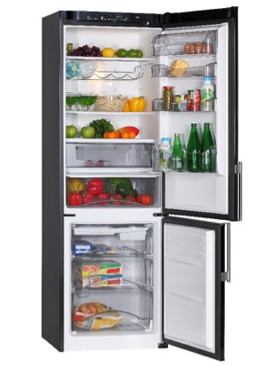
Part 3.0: Target Structures
Activity 3.2: Extension
Notes:
3.2 There Aren’t Many Eggs
Optional Extension
INSTRUCTIONS
Have the Students look at the picture and make sentences with “not much,” “not many,” etc. to describe what they see.
Each Student should produce at least three full sentences.

Slide 29
Part 3.0: Target Structures
Activity 3.2: Feedback
Student 1
Student 2
Student 3
Student 4
Great job!
Great job!
Great job!
Great job!
Well done
Well done
Well done
Well done
Good try
Good try
Good try
Good try
More practice
More practice
More practice
More practice
Feedback
Notes:
3.2 There Aren’t Many Eggs
FEEDBACK
Quickly give the Students feedback on the target language they just practiced.
Remind them of other resources they can take advantage of to improve their English:
Go to Wall Street World to practice grammar and vocabulary.
Review the Student Manual or Digital Book to study grammar and vocabulary.
Attend Complementary Classes to practice using grammar and vocabulary.
Join Social Clubs to practice speaking skills.

Slide 30
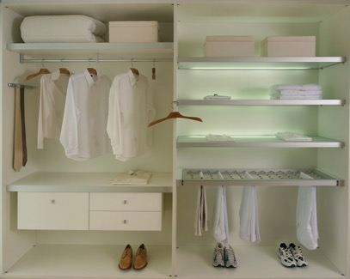
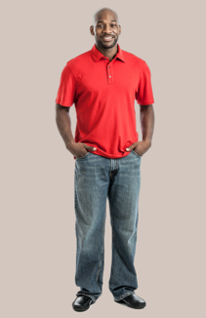

Part 4.0: Communication
Activity 4.1: Context Creation
.
There aren’t many clothes in the
closet, so what should you do?
We need to go shopping
Notes:
4.1 Clothes Shopping (10 min)
Allow one minute for this slide.
OBJECTIVES
Can name some basic articles of clothing (dress; hat; jacket, jeans; pants, skirt; socks; suit; sweater; t-shirt; tennis shoes; tie; top; trainers; trousers)
Can express polite offers and preference using would like/would like to (Would you like me to turn it down?)
Can describe quantity using not + much/many with some control (There isn’t much room to walk in here.)
INSTRUCTIONS
#1. Have a Student read the question. [There aren’t many clothes in the closet, so what should you do?]
#2. Elicit a response.
#3. Reveal the sample answer. [We need to go shopping.]
TEACHING TIPS
Brainstorm/elicit a variety of the target language, which will be used and assessed during the practice.
Elicit from each student.
It helps to board elicited language.

Slide 31
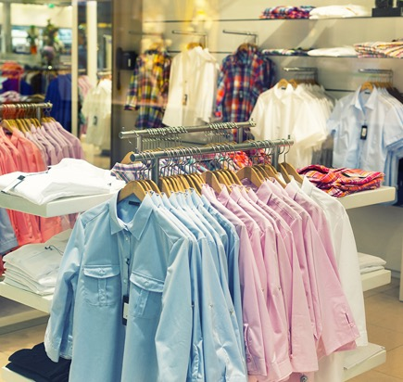
Part 4.0: Communication
Activity 4.1: Practice
Student A
Talk to the salesperson and ask for these things: warm sweater, white t-shirt, warm coat, a business suit, soap, toothpaste
Student B
Tell the customer what you have:
You have two sweaters left
You have hundreds of white t-shirts
You have five coats
You have ten different business suits
You have one bar of soap left
You have no toothpaste
Notes:
4.1 Clothes Shopping
Allow five minutes for this slide.
INSTRUCTIONS
Tell Student A, “You are in the airport shop and you are going on a business trip. You need to buy some things. You are the customer.”
Tell Student B, “You are a salesperson.”
Draw the Students’ attention to the information on the screen and give them one minute to read it and prepare.
Tell Student B, “Welcome your customer to the shop, please.”
After Student B greets Student A, they should perform the role-play.
Next, have the Students change roles and repeat the role-play.
SAMPLE DIALOGUE
A: Hello, can I help you?
B: Yes, I would like a warm sweater.
A: I don’t have many. Would you like this one?
B: Yes, thank you. I would also like a business suit.
A: I have many of those. Which one would you like?
B: I’d like the black one.
A: What else would you like?
B: Do you have any soap?
A: I don’t have much.
TEACHING TIP
Before repeating the role-play, give the Students feedback on the first role-play, and suggest ways to improve, for example by using more target language such as “would like” or “not many/much.”

Slide 32
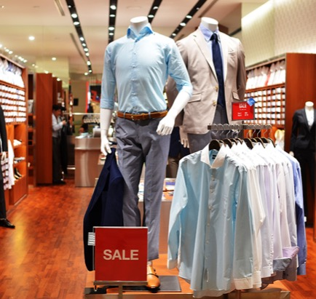
Part 4.0: Communication
Activity 4.1: Practice
Student C
Talk to the salesperson and ask for these things: green jacket, blue t-shirt, warm coat, shoes, soap, toothpaste
Student D
Tell the customer what you have:
You have no green jackets
You have several blue t-shirts
You have one coat
You have ten different business suits
You have hundreds of bars of soap
You have some toothpaste
Notes:
4.1 Clothes Shopping
Allow four minutes for this slide.
INSTRUCTIONS
Tell Student C, “You are in a shop in town. You need to buy some things. You are the customer.”
Tell Student D, “You are a salesperson.”
Draw the Students’ attention to the information on the screen and give them one minute to read it and prepare.
Tell Student D, “Welcome your customer to the shop, please.”
After Student D greets Student C, they should perform the role-play.
Next, have the Students change roles and repeat the role-play.
TEACHING TIP
Before repeating the role-play, give the Students feedback on the first role-play, and suggest ways to improve, for example by using more target language such as “would like” or “not many/much.”

Slide 33
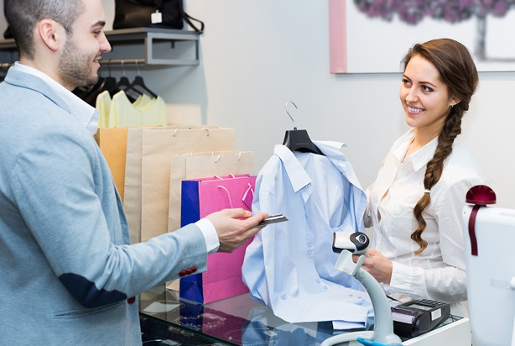
Part 4.0: Communication
Activity 4.1: Extension
?
.
Notes:
4.1 Clothes Shopping
Optional Extension
INSTRUCTIONS
Have the Students repeat the role play without using the cues and using different items.

Slide 34
Part 4.0: Communication
Activity 4.1: Feedback
 |  | Great job! | Well done | Good try | Need more practice
Student 1 | Range: How well you produce a range of language
 | Accuracy: How often you make mistakes
 | Quality of interaction: How well you ask and answer questions
 | Fluency and Spoken Production: How clearly you present ideas
Student 2 | Range: How well you produce a range of language
 | Accuracy: How often you make mistakes
 | Quality of interaction: How well you ask and answer questions
 | Fluency and Spoken Production: How clearly you present ideas
Student 3 | Range: How well you produce a range of language
 | Accuracy: How often you make mistakes
 | Quality of interaction: How well you ask and answer questions
 | Fluency and Spoken Production: How clearly you present ideas
Student 4 | Range: How well you produce a range of language
 | Accuracy: How often you make mistakes
 | Quality of interaction: How well you ask and answer questions
 | Fluency and Spoken Production: How clearly you present ideas
Notes:
4.1 Clothes Shopping
FEEDBACK
Quickly give the Students feedback on the target language they just practiced.
If you have a full class, focus on just a couple points each (i.e. their greatest strength and what they need to work on).
Remind them of other resources they can take advantage of to improve their English:
Go to Wall Street World to practice grammar and vocabulary.
Review the Student Manual or Digital Book to study grammar and vocabulary.
Attend Complementary Classes to practice using grammar and vocabulary.
Join Social Clubs to practice speaking skills.

Slide 35
Part 4.0: Communication
Activity 4.2: Context Creation
Where do you go to buy clothes? Why?
.
Notes:
4.2 Clothing Discussion (10 min)
Allow one minute for this slide.
OBJECTIVE
Can name some basic articles of clothing (dress; hat; jacket, jeans; pants, skirt; socks; suit; sweater; t-shirt; tennis shoes; tie; top; trainers; trousers)
INSTRUCTIONS
#1. Have a Student read the question. [Where do you go to buy clothes? Why?]
#2. Elicit brief answers and then say, “You are going to talk about clothes with your classmates.”
TEACHING TIPS
Brainstorm/elicit a variety of the target language, which will be used and assessed during the practice.
Elicit from each student.
It helps to board elicited language.

Slide 36

Part 4.0: Communication
Activity 4.2: Practice
What do people wear to work?
What do people wear to school?
What do people wear to stay home all day?
What do people wear to do exercise?
What do people wear in hot weather?
What do people wear in cold weather?
Do you like to buy clothes? Why or why not?
?
.
Notes:
4.2 Clothing Discussion
Allow nine minutes for this slide.
INSTRUCTIONS
Say to the Students, “Talk to your classmates. Ask and answer the questions. Give detailed answers. Also ask more questions (like why, where, and when).”
Have the Students talk with their classmates.
Next, say, “Tell me what you learned from your classmates.”
Have the Students give feedback on what they learned from each other.
TEACHING TIP
Encourage the Students to make their answers as long and as detailed as they can.

Slide 37
Part 4.0: Communication
Activity 4.2: Extension
What don’t people wear to work?
What don’t people wear to school?
What don’t people wear to stay home all day?
What don’t people wear to do exercise?
What don’t people wear in hot weather?
What don’t people wear in cold weather?
?
.
Notes:
4.2 Clothing Discussion
Optional Extension
INSTRUCTIONS
Have the Students repeat the activity, but instead of answering the “What do” questions on the handout, have the Students answer “What don’t” for each question. For example,
What don’t people wear to work?
What don’t people wear to school?
TEACHING TIP
Encourage the Students to make their answers as long and as detailed as they can.

Slide 38
Part 4.0: Communication
Activity 4.2: Feedback
 |  | Great job! | Well done | Good try | Need more practice
Student 1 | Range: How well you produce a range of language
 | Accuracy: How often you make mistakes
 | Quality of interaction: How well you ask and answer questions
 | Fluency and Spoken Production: How clearly you present ideas
Student 2 | Range: How well you produce a range of language
 | Accuracy: How often you make mistakes
 | Quality of interaction: How well you ask and answer questions
 | Fluency and Spoken Production: How clearly you present ideas
Student 3 | Range: How well you produce a range of language
 | Accuracy: How often you make mistakes
 | Quality of interaction: How well you ask and answer questions
 | Fluency and Spoken Production: How clearly you present ideas
Student 4 | Range: How well you produce a range of language
 | Accuracy: How often you make mistakes
 | Quality of interaction: How well you ask and answer questions
 | Fluency and Spoken Production: How clearly you present ideas
Notes:
4.2 Clothing Discussion
FEEDBACK
Quickly give the Students feedback on the target language they just practiced.
If you have a full class, focus on just a couple points each (i.e. their greatest strength and what they need to work on).
Remind them of other resources they can take advantage of to improve their English:
Go to Wall Street World to practice grammar and vocabulary.
Review the Student Manual or Digital Book to study grammar and vocabulary.
Attend Complementary Classes to practice using grammar and vocabulary.
Join Social Clubs to practice speaking skills.

Slide 39
Encounter 19
Overall Feedback
 |  | Great job! | Well done | Good try | Need more practice
 | Activity 2.1: What Are They Wearing?
 | Activity 3.1: Making Choices
 | Activity 3.2: There Aren’t Many Eggs
 | Activity 4.1: Clothes Shopping
 | Activity 4.2: Clothing Discussion
Student 1
Feedback
Notes:
OVERALL FEEDBACK (3–5 min)
Allow one minute for this slide.
Explain to the Students that you will now be giving them an overall assessment and recommendations. Use the following prompts to help you explain the assessment:
First, you did a really good job of…
The areas where you could use a little more practice are…
The language points I didn’t hear you use were...
As a result, I’d recommend that you… [continue on to Unit 20… work on (X, Y, Z ) and repeat Encounter 19].
Do you have any questions?

Slide 40
Encounter 19
Overall Feedback
 |  | Great job! | Well done | Good try | Need more practice
 | Activity 2.1: What Are They Wearing?
 | Activity 3.1: Making Choices
 | Activity 3.2: There Aren’t Many Eggs
 | Activity 4.1: Clothes Shopping
 | Activity 4.2: Clothing Discussion
Student 2
Feedback
Notes:
OVERALL FEEDBACK (3–5 min)
Allow one minute for this slide.
Explain to the Students that you will now be giving them an overall assessment and recommendations. Use the following prompts to help you explain the assessment:
First, you did a really good job of…
The areas where you could use a little more practice are…
The language points I didn’t hear you use were...
As a result, I’d recommend that you… [continue on to Unit 20… work on (X, Y, Z ) and repeat Encounter 19].
Do you have any questions?

Slide 41
Encounter 19
Overall Feedback
 |  | Great job! | Well done | Good try | Need more practice
 | Activity 2.1: What Are They Wearing?
 | Activity 3.1: Making Choices
 | Activity 3.2: There Aren’t Many Eggs
 | Activity 4.1: Clothes Shopping
 | Activity 4.2: Clothing Discussion
Student 3
Feedback
Notes:
OVERALL FEEDBACK (3–5 min)
Allow one minute for this slide.
Explain to the Students that you will now be giving them an overall assessment and recommendations. Use the following prompts to help you explain the assessment:
First, you did a really good job of…
The areas where you could use a little more practice are…
The language points I didn’t hear you use were...
As a result, I’d recommend that you… [continue on to Unit 20… work on (X, Y, Z ) and repeat Encounter 19].
Do you have any questions?

Slide 42
Encounter 19
Overall Feedback
 |  | Great job! | Well done | Good try | Need more practice
 | Activity 2.1: What Are They Wearing?
 | Activity 3.1: Making Choices
 | Activity 3.2: There Aren’t Many Eggs
 | Activity 4.1: Clothes Shopping
 | Activity 4.2: Clothing Discussion
Student 4
Feedback
Notes:
OVERALL FEEDBACK (3–5 min)
Allow one minute for this slide.
Explain to the Students that you will now be giving them an overall assessment and recommendations. Use the following prompts to help you explain the assessment:
First, you did a really good job of…
The areas where you could use a little more practice are…
The language points I didn’t hear you use were...
As a result, I’d recommend that you… [continue on to Unit 20… work on (X, Y, Z ) and repeat Encounter 19].
Do you have any questions?

Slide 43




Part 5.0: Wrap-Up
A
B
C
D
Notes:
5.1 Guess the Person (5 min)
Allow three minutes for this slide.
OBJECTIVE
• To review and practice target language from the Unit
INSTRUCTIONS
Have the Students take turns describing one of the people they see. The other Students compete to see who can be first to identify the corresponding person.
Encourage the Students to ask questions if they need hints.

Slide 44

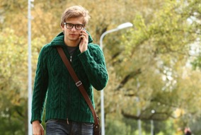


Part 5.0: Wrap-Up
A
B
C
D
Notes:
5.1 Guess the Person
Allow two minutes for this slide.
INSTRUCTIONS
Have the Students take turns describing one of the people they see. The other Students compete to see who can be first to identify the corresponding person.
Encourage the Students to ask questions if they need hints.

Slide 45

Thank you for coming.
We hope you enjoyed the class.
Don’t forget
to leave feedback!
Teacher
Class was fun
Instructions were clear
«««««
«««««
«««««
«««««
«««««
«««««

Slide 46
© 2017 by Pearson Education Limited All rights reserved.
No part of this publication may be reproduced, stored in a retrieval system, or transmitted in any form or by any means, electronic, mechanical, photocopying, recording or otherwise without the permission of the Publishers.
This material is the intellectual property of Pearson Education Limited.
Image Credits:
johndwilliams/Fotolia; Olga Sapegina/Fotolia; Hugo Félix/Fotolia; Pitcher/Fotolia; Voyagerix/Fotolia; Minerva Studio/Fotolia; beeboys/Fotolia; Maridav/Fotolia; Kaspars Grinvalds/ Fotolia; alena0509/Fotolia; dexailo/Fotolia; maonakub/Fotolia; igorphoto50/Fotolia; mates/Fotolia; Wollwerth Imagery/Fotolia; giromin/Fotolia; massimhokuto/Fotolia; cristovao31/Fotolia; ekostsov/ Fotolia; Adam Wasilewski/Fotolia; blueringmedia/Fotolia; Valua Vitaly/Fotolia; eurobanks/Fotolia; sumire8/Fotolia; indigolotos/Fotolia; Monkey Business/Fotolia; pixelrobot/Fotolia; Lane Erickson/Fotolia; Nomad_Soul/Fotolia; tang90246/Fotolia; JackF/Fotolia; luismolinero/Fotolia; Yeko Photo Studio/Fotolia; darkbird/Fotolia; Maridav/Fotolia; Giuseppe Porzani/Fotolia; artisticco/Fotolia; lulu/Fotolia;

